Slide 1


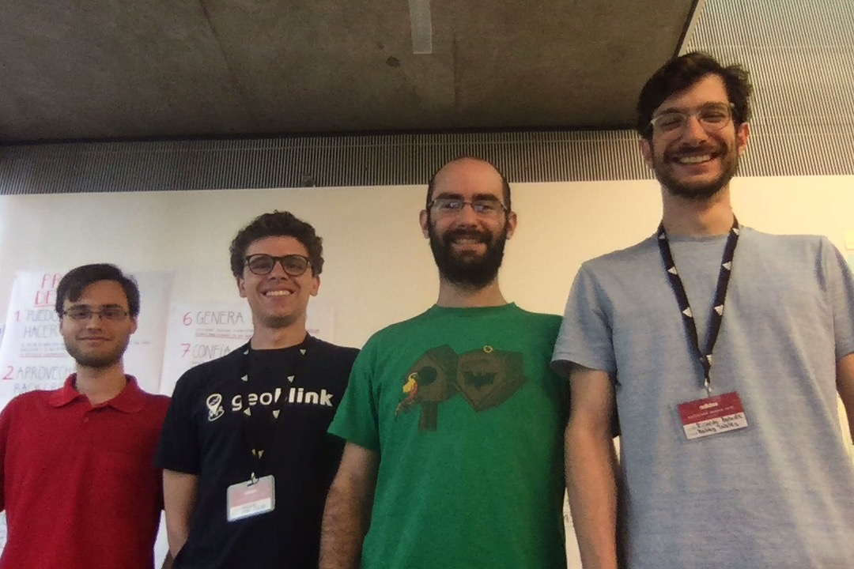


BOBBY TABLES
TEAM PICTURE
Gabriel Fürstenheim
Ricardo Boluda
Lluís Ulzurrun
Ignacio Moreno
ENABLING SPORT THROUGH TECHNOLOGY
Health SDK
NodeJS
TECHNOLOGIES
Spotify API
Swift
Song Classifier

